Slide 1
Enhancing Network Security with FortiGate Firewalls
Course: CSCE 5585.
Group No: 8
Presented by: Likith Salike, Aryanth Reddy Kondreddy,
Ashish Reddy Chidipudi.

Slide 2
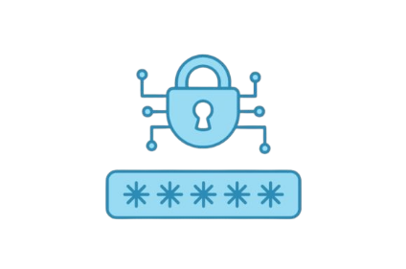
Project Overview
Aim: Design a scalable and secure network for head and branch offices.
Tools: GNS3, FortiGate firewalls, and VLAN configuration.
Focus: Ensure secure communication between offices via a site-to-site VPN.
Approach: VLAN segmentation, firewall deployment, and intrusion prevention systems.
Goal: Prevent unauthorized access while ensuring reliable data transmission.

Slide 3
Virtual Lab Setup
GNS3 was used to simulate the network environment.
Included components: multilayer switch, virtual PCs, server, and firewalls.
FortiGate firewalls governed perimeter security for both offices.
Trunking and inter-VLAN routing configured in the switch.
Connectivity tests validated the setup with tools like VNC Viewer and Telnet.

Slide 4
Network Design and Segmentation
VLANs created for ICT, HR, Finance, and Sales (VLANs 40, 10, 20, 30).
Each VLAN restricted to specific departmental traffic for security.
DMZ set up for hosting public services like web servers.
Site-to-site VPN established between head and branch offices.
Design ensured scalability, efficiency, and secure data transmission.

Slide 5
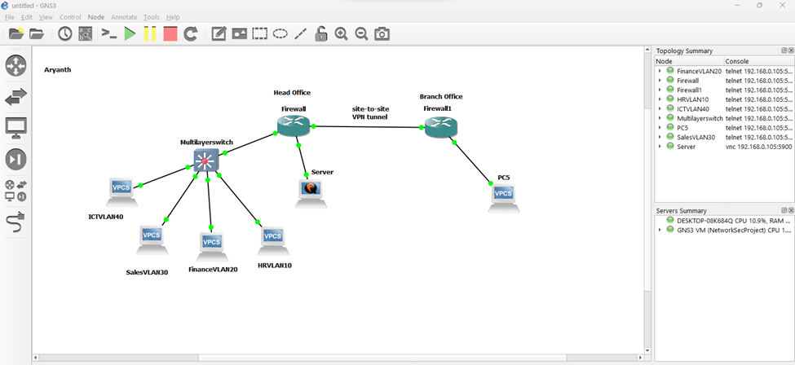
Network Segmentation Layout

Slide 6
Firewall Deployment
FortiGate firewall interfaces configured as WAN, LAN, and DMZ.
WAN connected to the internet with a public IP address.
LAN secured internal communications between VLANs.
DMZ provided limited access to public-facing services (e.g., email, SSH).
Policies restricted traffic to ensure only necessary services were allowed.

Slide 7
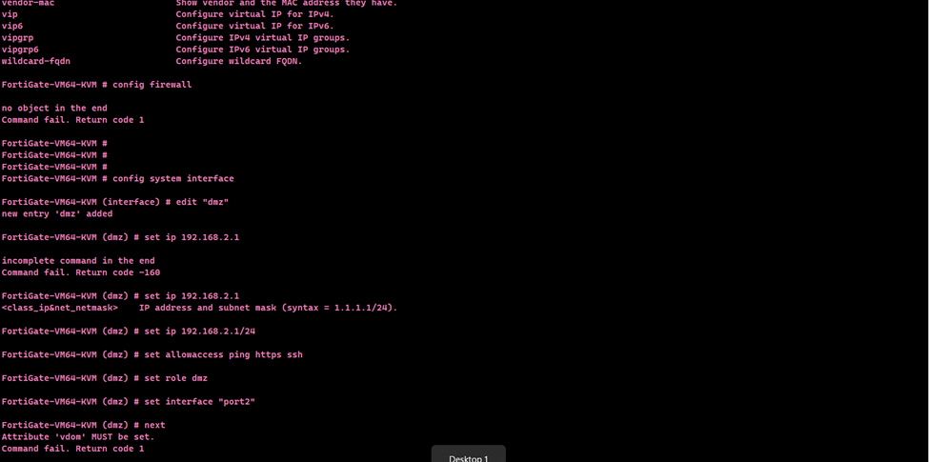
Firewall Interface Configuration

Slide 8
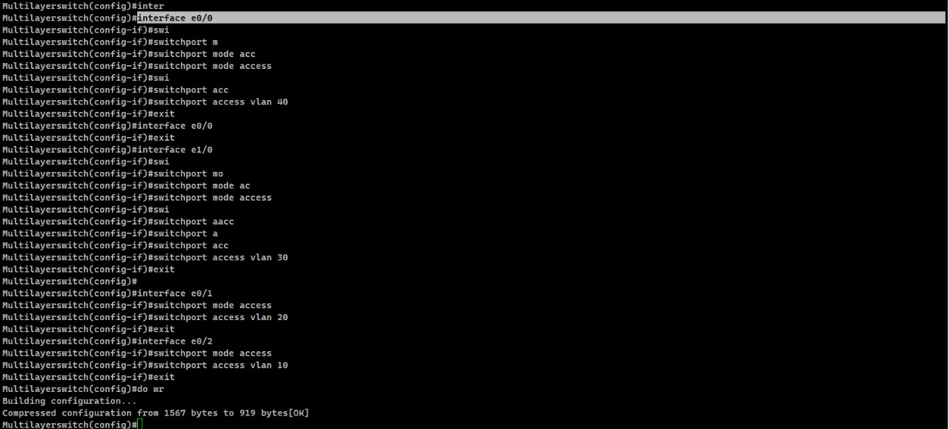
Setting Access Ports for VLAN

Slide 9
VPN Configuration
Phase 1: WAN interface configured with pre-shared key and AES256-SHA256 encryption.
Phase 2: Subnet traffic routes set for secure communication (192.168.1.0/24 and 10.0.0.0/24).
Policies allowed two-way traffic between LAN and VPN tunnel.
Connectivity tests confirmed secure transmission and tunnel status.
The VPN ensured encrypted data sharing between remote sites.

Slide 10
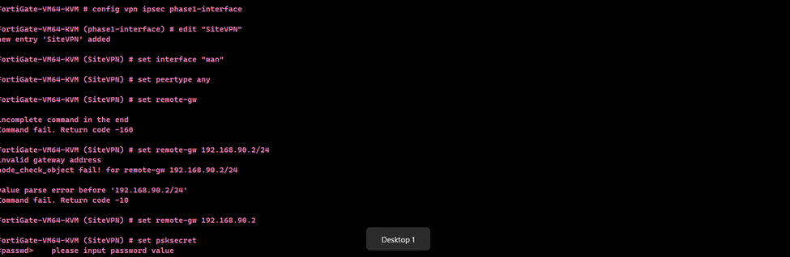
Site-to-Site VPN Tunnel Status

Slide 11
Intrusion Detection and Prevention System (IDS/IPS)
FortiGate IPS sensor monitored traffic for malicious activities.
Known threats were blocked while all potential incidents were logged.
Severity and scope set to cover 100% of traffic.
IPS integrated into the WAN-DMZ traffic zone for proactive defense.
Logs confirmed real-time intrusion detection and mitigation.

Slide 12
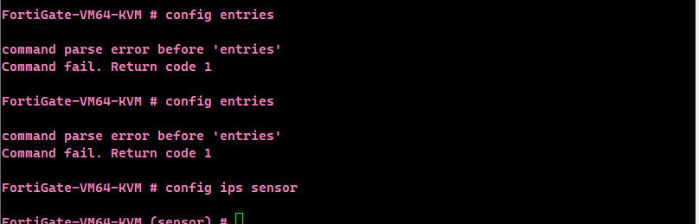
IPS Monitoring Logs

Slide 13
Vulnerability Testing and Exploitation
Nmap scan revealed several open ports, including port 80 (HTTP).
Metasploit framework was used to exploit the exposed HTTP port.
The exploit failed, possibly due to detection by the Intrusion Prevention System (IPS) in the firewall.
Testing highlights the need to optimize firewall policies for better security.

Slide 14
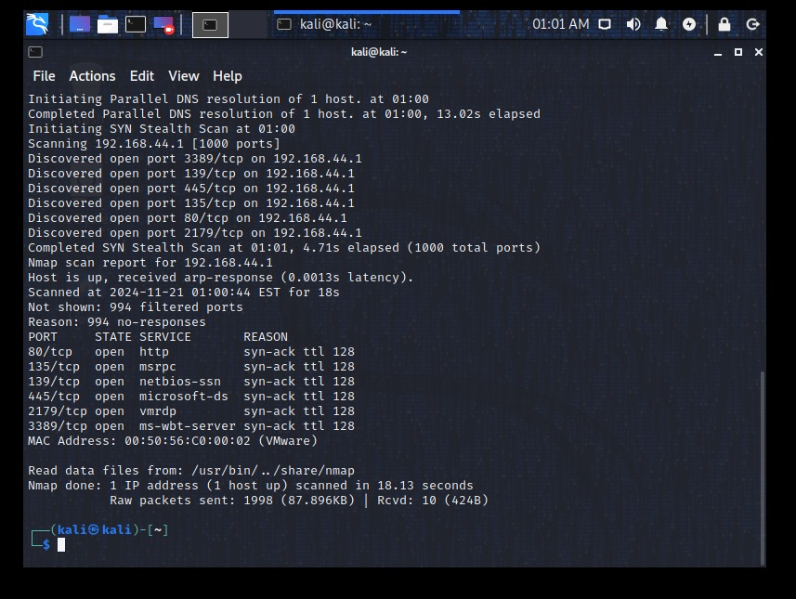
Nmap scan identifying open ports, including port 80 for HTTP

Slide 15
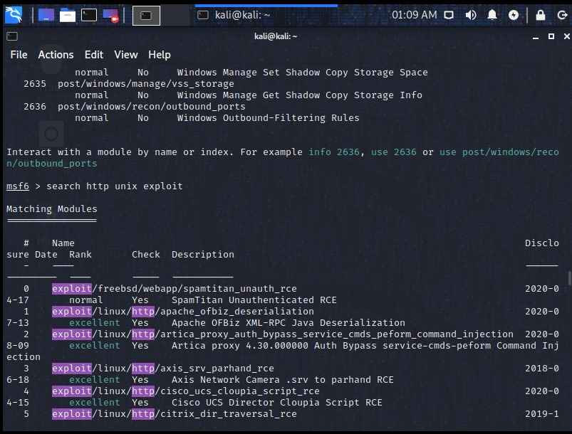
Metasploit framework used to search and configure HTTP exploits for port 80

Slide 16
Exploit Attempt and Outcome
The Metasploit framework configured an exploit for the Apache OFBiz deserialization vulnerability.
The exploit session failed due to SSL/TLS misconfiguration or firewall detection.
Demonstrates the importance of secure configurations for exposed services.

Slide 17
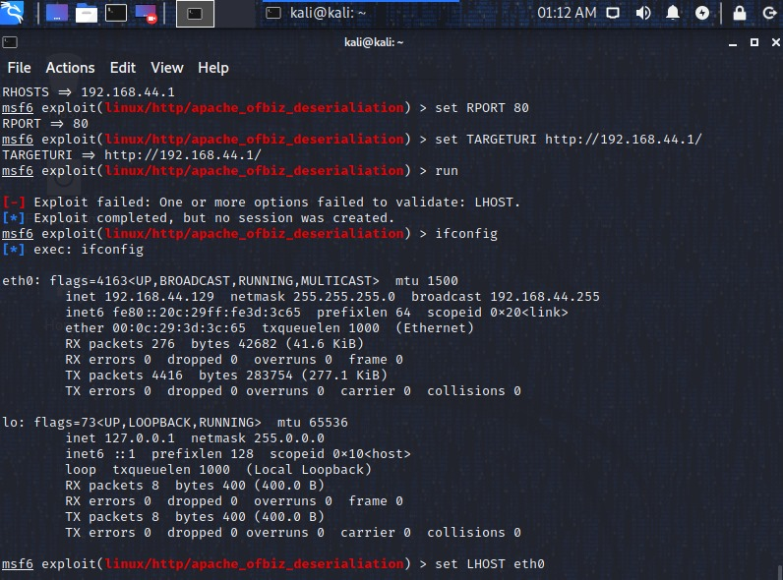
Failed exploit due to SSL/TLS misconfiguration or IPS detection by the firewall

Slide 18
Risk and Remediation
Risk: Exposing port 80 (HTTP) creates a high-security risk, labeled as a "security misconfiguration."
Risk: Misconfigured or overly permissive firewall policies leave critical vulnerabilities.
Remediation: Optimize firewall rules to close unused ports like port 80.
Remediation: Deploy enhanced monitoring tools to detect and block malicious activity.

Slide 19
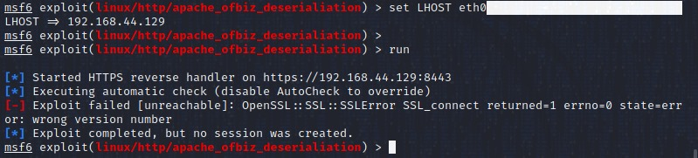
SSL error in Metasploit exploit run highlights configuration gaps

Slide 20
Conclusion
Continuous monitoring and optimization of network security settings are necessary.
Exposed ports such as port 80 represent a significant risk.
Immediate action, such as policy/rule optimizations, is required to protect against potential exploitation.

